Slide 1
PAYMENT WALLET
Team member:
Konda sriharika patel

Slide 2
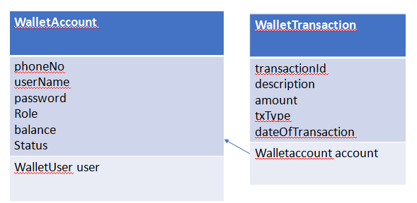
Class diagram

Slide 3
Use case diagram
Valid User PhoneNo
Fetch Transactions Between Dates
Wallet User
System Backend
Fetch Transactions by phoneNo

Slide 4
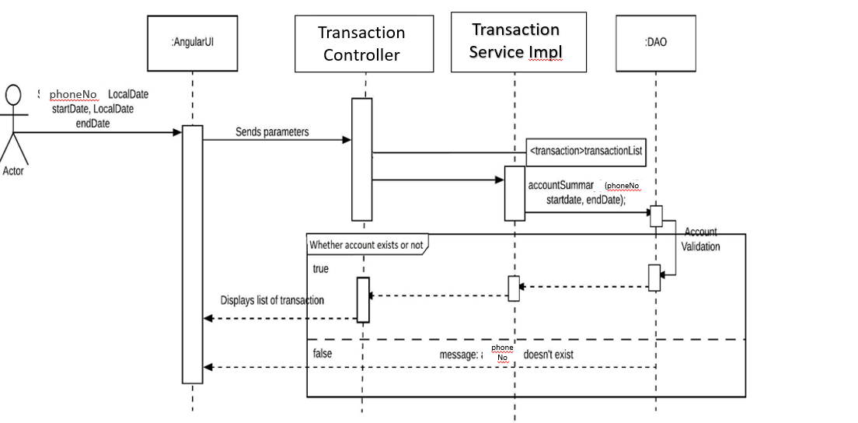
Sequence diagram

